Slide 1
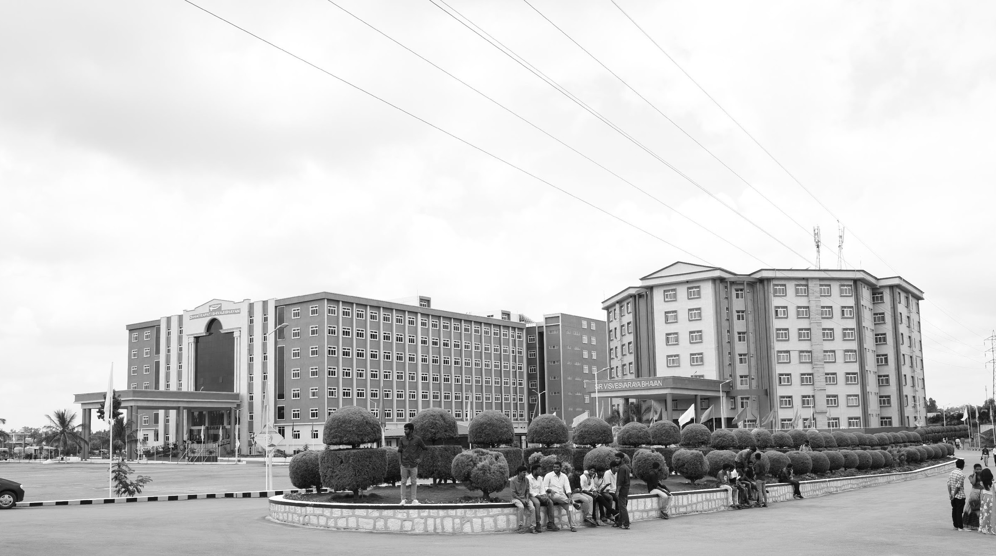

Autonomous System for Detecting Drainage Blockages in Urban Areas
Major Project
Project ID: A-14
AY 2021-25
GITAM (Deemed-to-be) University
Department of Electrical Electronics and Communication Engineering
Project Team:
NITHISH KUMAR MP - BU21EECE0100518
B.V. KISHORE KUMAR - BU21EECE0100333
M.SRI SAI HARSHITH – BU21EECE0100407
Project Mentor:
Dr. Ramesha.M
Project In-charge:
Dr. Ambar Bajpai
www.gitam.edu

Slide 2
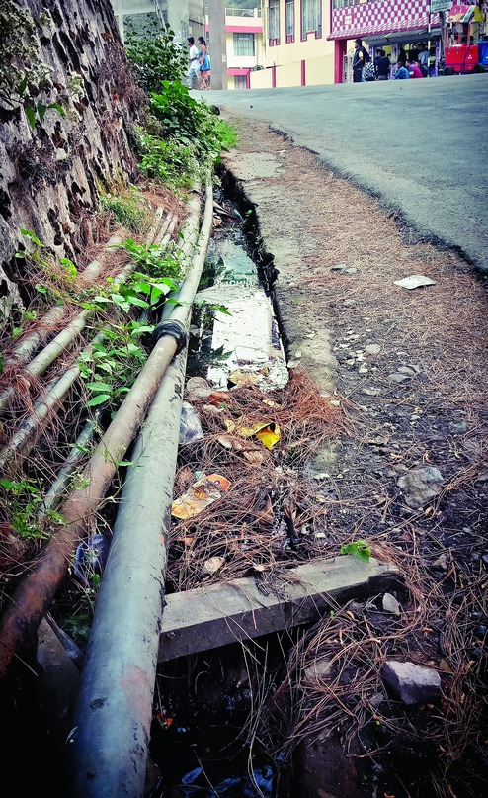
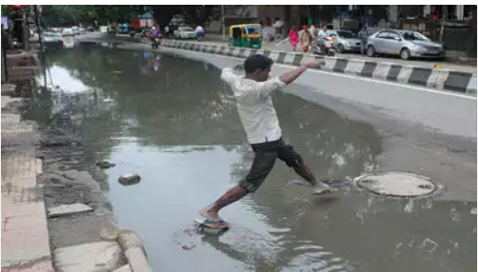
INDRODUCTION:
The Smart Robot System project intends to develop an autonomous robot for the inspection and maintenance of Karnataka's city drains. The robot employs sophisticated sensors such as ultrasonic, infrared, and cameras to identify obstructions in drainage pipes. It also incorporates GSM modules to report locations accurately and transmit data in real-time to local authorities for effective maintenance in a timely manner. The project minimizes human labor, improves safety and public health and infrastructure, and entails examining drainage networks, developing slender robots, and field testing, which helps in smart city efforts aimed at enhancing sanitation and averting urban flooding.

Slide 3
ABSTRACT:
Urban drainage systems are often clogged with solid waste, plastic, and mud, resulting in waterlogging, flooding, and health risks. Present approaches towards the identification and removal of blockages are manual, time-consuming, and inefficient. This project envisions a Smart Robot System that automatically detects, identifies, and resolves urban drainage blockages. The robot employs sensors (infrared, ultrasonic, and water level) and cameras to detect obstructions, while GSM modules are used for real-time positioning tracking and data transmission. The system is designed to enhance drainage maintenance efficiency, save labor, and avoid flooding and health hazards. Through the use of IoT and robotics technologies, this solution provides an efficient and sustainable solution for urban drainage management.

Slide 4
Objective and Goals
Objective
Design an Autonomous Robot: Develop a robot capable of navigating drainage systems to detect and map blockages.
Enhance Efficiency: Minimize manual labor and risks through autonomous navigation, reducing maintenance time and costs.
Improve Infrastructure Maintenance: Provide a scalable solution supporting smart city infrastructure goals.
Use Advanced Technologies: Integrate tools like ultrasonic sensors, neural networks, and IoT for improved blockage detection and real-time monitoring.
Goals
Main Goals
Design and prototype a robot capable of navigating urban drainage systems to detect and locate blockages.
Use sensors (ultrasonic, infrared, and water level) and cameras to identify blockages in real-time.
Minimize the need for manual inspection and cleaning of drainage systems, making the process safer and more efficient.
Additional Goals
Improve urban infrastructure maintenance through a scalable solution for drainage systems.
Use advanced technologies like ultrasonic sensors, infrared cameras, and IoT for real-time monitoring.

Slide 5
Project Plan
Gant Chart - Milestones and Activities
Resources : https://www.officetimeline.com/gantt-chart/how-to-make/excel & https://www.teamgantt.com/

Slide 6
Literature Survey
Title of paper​ | Author and Year | Abstract​ | Outcome​ | Methodology​ | Research gap​
Design and Implementation of Smart Drainage System for Bangladesh | Alam, M. S.; Sitara, S.; Irin, A. S.; Anu, A. T.; Ahmed, A.; Zishan, M. S. R Year:- 2023 | This paper addresses the challenges of monitoring underground drainage systems in Bangladesh. It proposes an IoT-based microcontroller-driven smart drainage system to remotely monitor and manage parameters like water levels, blockages, and rainfall rates. | It effectively reduced the manual effort and irregularities in drainage system maintenance, offering a scalable and efficient solution for urban water | The system utilized a master-slave microcontroller architecture integrated with IoT sensors. Simulations demonstrated its functionality under various rainfall scenarios. | The paper lacks provisions for filtering solid waste within drains and does not offer a public interface for road condition updates.
Design of IoT-Based Smart Drain Monitoring System Using Alert Messages | Ghodmare, A.; Pukhal, S.; Khode, A.; Agrawal, R.; Ghodmare, S.; Jajulwar, K. Year:- 2022 | This research introduces an IoT-enabled system to streamline urban drainage management by detecting blockages quickly and minimizing manpower requirements. | The system successfully identified blockages using a locator stick integrated with IoT devices It provided real-time data on blockages, reducing the time and labor required for manual inspection and improving the efficiency of urban drainage maintenance. | A combination of ultrasonic sensors and GPS modules was used to detect blockages and pinpoint their locations. | The system requires further optimization for large-scale deployment and does not account for the economic constraints in underdeveloped regions.

Slide 7
Literature Survey
Title of paper​ | Author and Year | Abstract​ | Outcome​ | Methodology​ | Research gap​
Self-Reconfigurable Drains Map Robot Which is Capable to Level Shift Specialized on Drain Maze. | Parween, R.; Hayat, A.A.; Elangovan, K.; Apuroop, K.G.S.; Heredia, M.V.; Elara. Year:- 2020 | The development of a quadruped drain mapping robot called Tarantula-II based on giraffe’s leg folding mechanism helps in traversing the uniqueness of drain system levels. | The drain mapping robot exhibits successful reconfiguration and level shifting ability that facilitates seamless mapping drains. | A biologically inspired leg mechanism, kinematic adjustments, and posture correction methods are employed in the robot design for level adaptation and stable motion. | Most of the robotic systems previously developed for drain inspection are not capable of attending to large drainage width and level adaptability hence the need for the design of more adaptable designs.
Raptor: A New Approach to the Drain Inspection Robot Design with Reconfigurable Features | Muthugala, M.A.V.J.; Palanisamy, P.; Samarakoon, S.M.B.P.; Padmanabha, S.G.A.; Elara, M.R.; Terntzer, D.N. Year:- 2021 | This article outlines the Raptor who is a new drain inspection robot which has a manually adjustable wheel axle element to more effectively adapt to areas of various geometrics. | Results show that defenses Raptor's position thus allowing Raptor to center itself in the middle of drains which improves the efficaciousness and precision of the inspections. | The changeable design of the wheels of a robot was used and autonomous motion of the robot was performed on a fuzzy logic controller. | Already undertaken attempts to design drain inspection robots are characterized by some inflexibility in operational geometry and provision for autonomous relocation which Raptor rectifies.

Slide 8
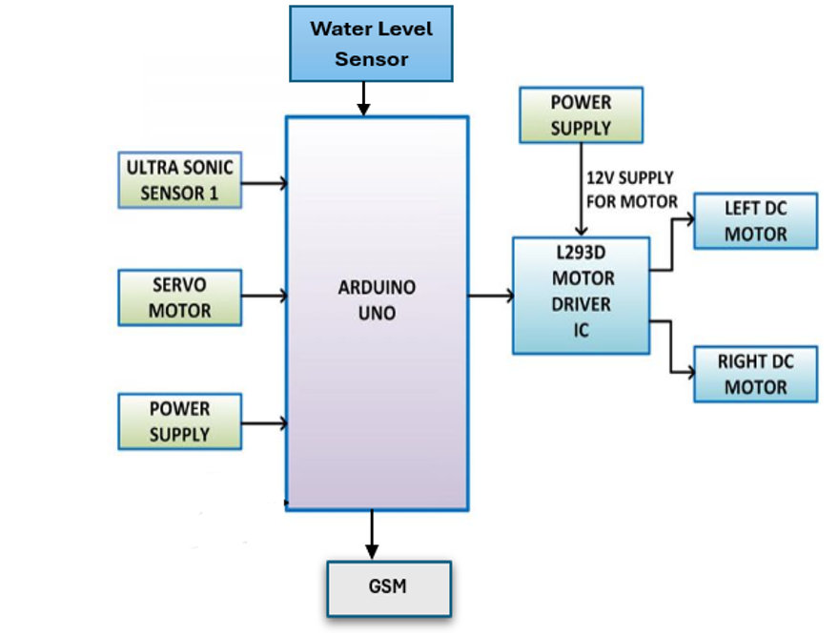
Structural Diagram :
Core Components:
Microcontroller: Arduino UNO
Sensors: Ultrasonic, Infrared, Water Level Sensors
Navigation: Servo Motors, Wheels
Communication:, GSM Module
Camera: For visual monitoring
Working Principle :
Robot navigates through the drainage.
Sensors detect blockages and collect data.
Data is transmitted to authorities for action.

Slide 9
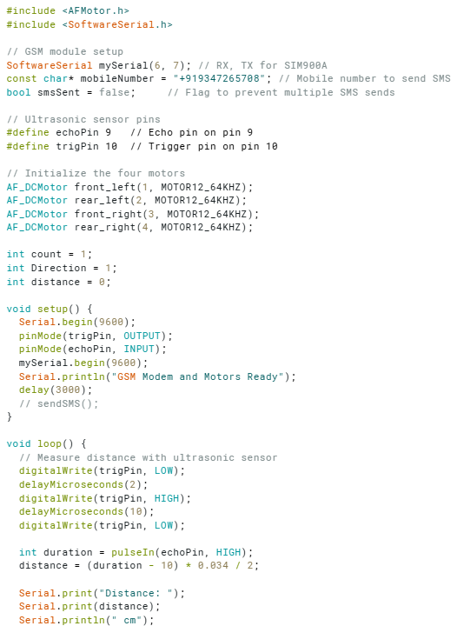
Code

Slide 10
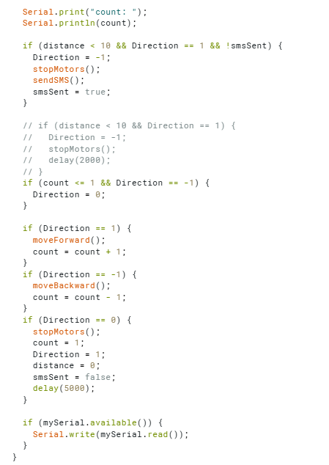
Code

Slide 11
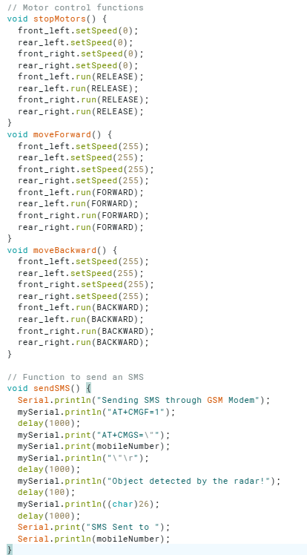
Code

Slide 12
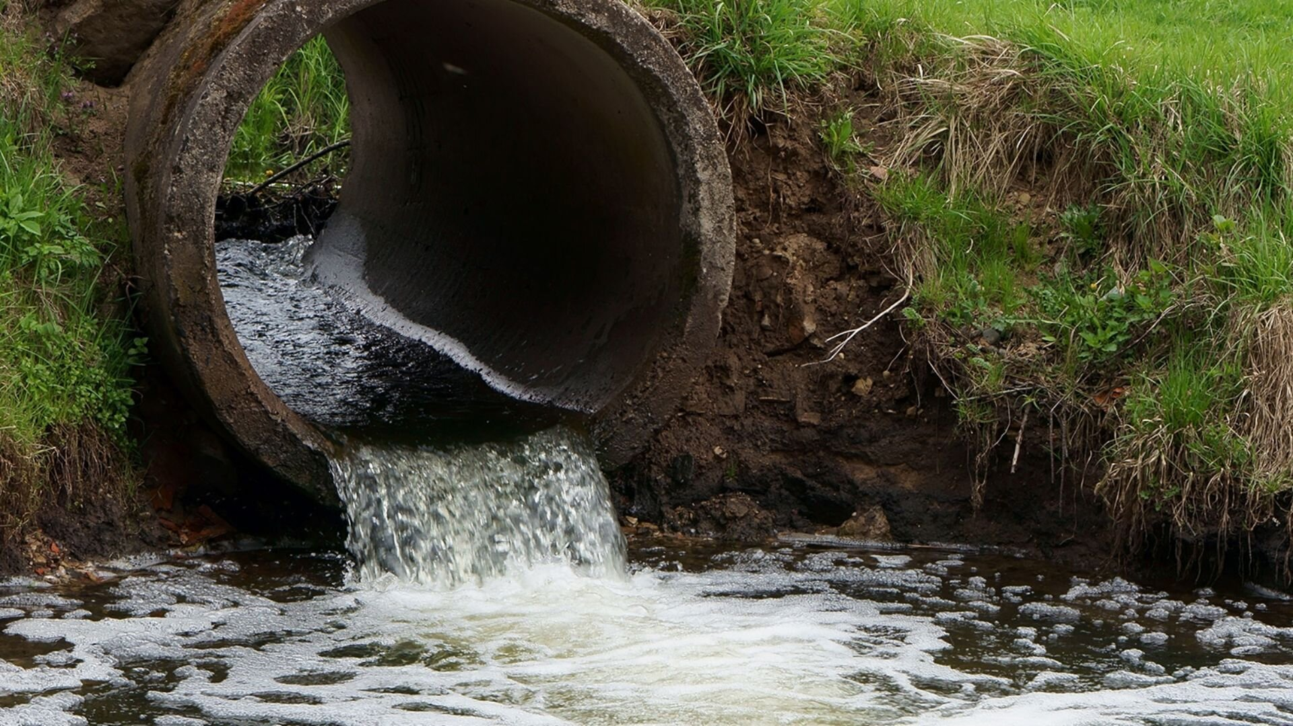
Implementation and Results
Iteration : Results + Validation against the use cases and test cases
Iteration 1: System Design and Development
Conduct a comprehensive study of urban drainage systems.
Design a compact, waterproof robotic structure.
Equip the robot with sensors for detecting blockages.
Implement a localization module using GSM for data transmission.
Build a user interface for monitoring and real-time data reception.
Test the robot in simulated environments to refine its design and detection algorithms.

Slide 13
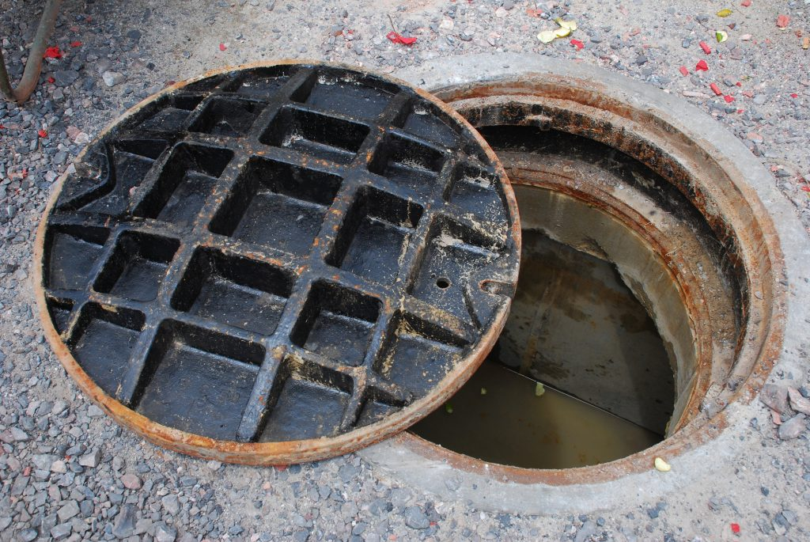
Iteration 2:
Field Deployment and Testing
Deploy the robot in selected urban drainage systems in Karnataka.
Assess performance in real-world conditions, including navigation through drainage networks.
Evaluate the reliability of sensors and communication modules in actual drainage systems.

Slide 14
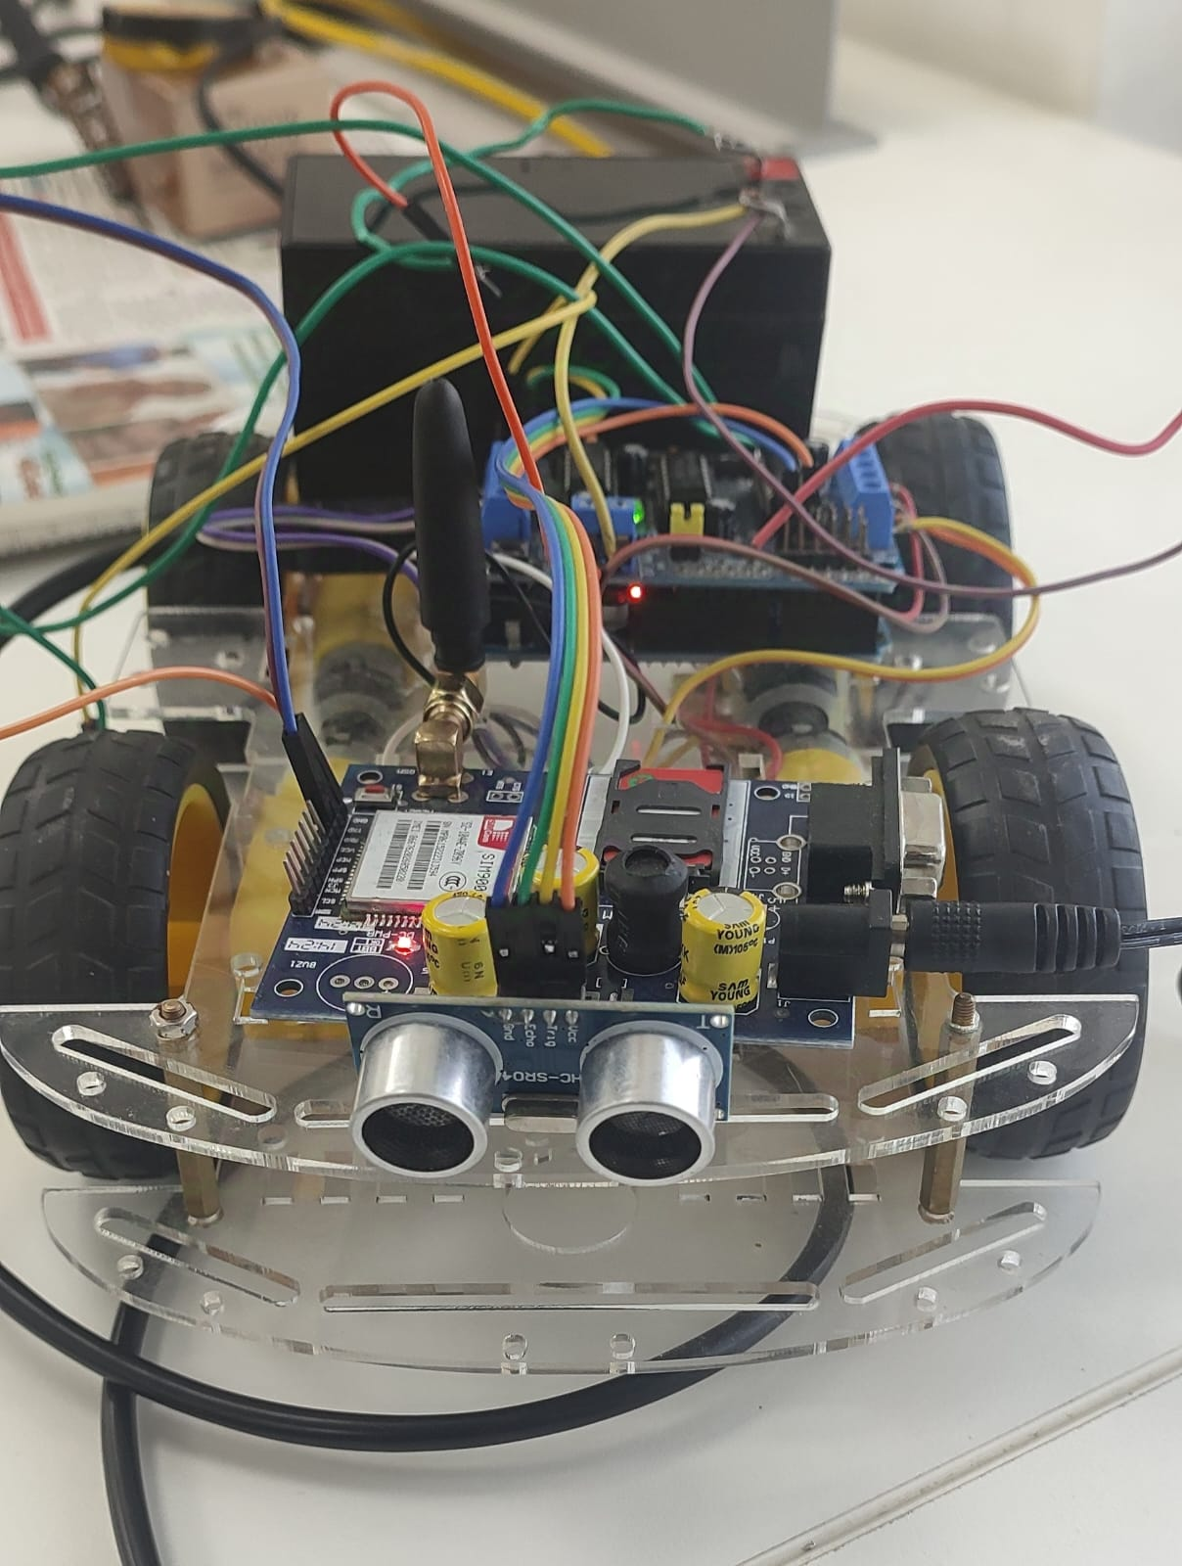
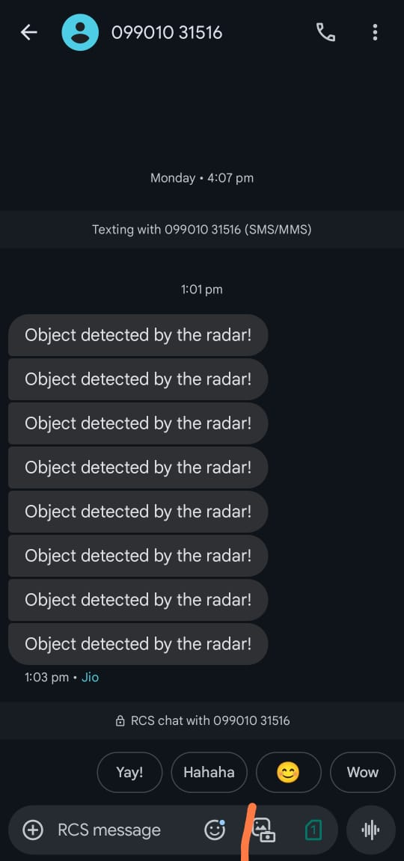
Fig: Robot
Fig: output Message

Slide 15
Contribution
Team Progress and Movement
Dataset Collection
Data Labelling and Annotation
Model Training
Testing
Deployment and Monitoring
Individual Contribution
Key contributions: Nitish Kumar MP
Sensor Integration
System Assembly
Key contributions: B.V. Kishore Kumar
Navigation System
Field Testing
Documentation & Report Preparation
Key contributions: M. Sri Sai Harshith
Model Training
Model Testing

Slide 17
Conclusion & Future Work
Summary and Conclusion
Summary:
The "Smart Robot System" was designed to detect and locate drainage pipe blockages in urban areas. This robot uses sensors, GSM modules to navigate drainage systems, find blockages, and send real-time data to authorities. The system reduces manual labor, improves safety, and ensures quicker maintenance, especially during the rainy season.
Conclusion:
The developed Smart Robot System offers a scalable and cost-effective solution that aligns with the objectives of smart city initiatives. It has the potential to revolutionize urban sanitation management and improve the quality of life for residents.
Future Work:
Future work on this project will focus on enhancing real-time data processing and incorporating energy-efficient components to extend the robot's operational time. Additionally, implementing a fully automated system for monitoring and maintaining drainage infrastructure remotely will further streamline urban drainage management and reduce human intervention.

Slide 18
References
Alam, M. S.; Sitara, S.; Irin, A. S.; Anu, A. T.; Ahmed, A.; Zishan, M. S. R. Design and Implementation of Smart Drainage System for Bangladesh. In Proceedings of the 3rd International Conference on Robotics, Electrical and Signal Processing Techniques (ICREST); IEEE: Dhaka, Bangladesh, 2023; pp. 346–351.
Ghodmare, A.; Pukhal, S.; Khode, A.; Agrawal, R.; Ghodmare, S.; Jajulwar, K. Design of IoT-Based Smart Drain Monitoring System Using Alert Messages. In Proceedings of the EasyChair Preprints; EasyChair: Nagpur, India, 2022; pp. 1–10.
Parween, R.; Hayat, A.A.; Elangovan, K.; Apuroop, K.G.S.; Heredia, M.V.; Elara, M.R. Design of a Self-Reconfigurable Drain Mapping Robot With Level-Shifting Capability. IEEE Access 2020, 8, 113429–11344
Muthugala, M.A.V.J.; Palanisamy, P.; Samarakoon, S.M.B.P.; Padmanabha, S.G.A.; Elara, M.R.; Terntzer, D.N. Raptor: A Design of a Drain Inspection Robot. In Sensors; MDPI: Basel, Switzerland, 2021; pp. 5742–5761.

Slide 19
THANK YOU
Have a Great Day !

